Slide 1
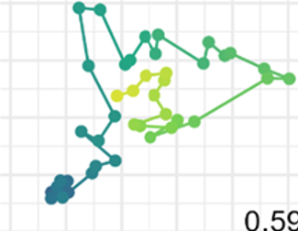
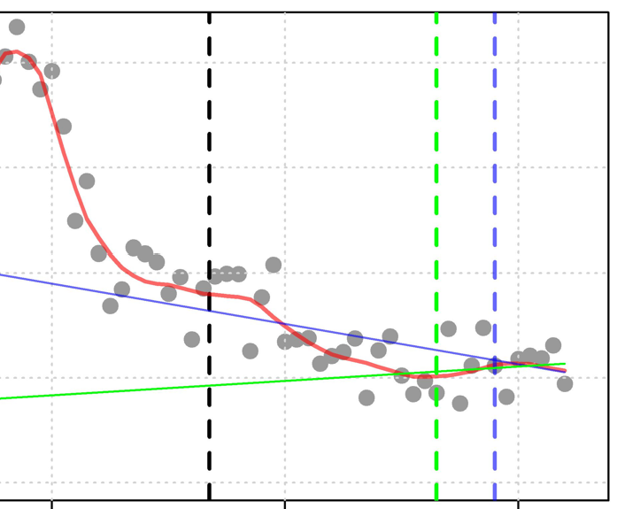
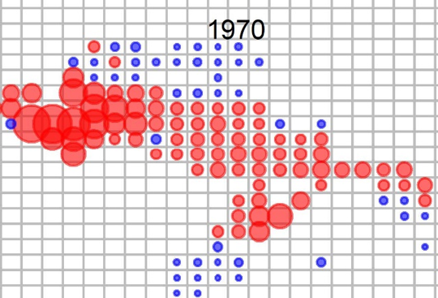
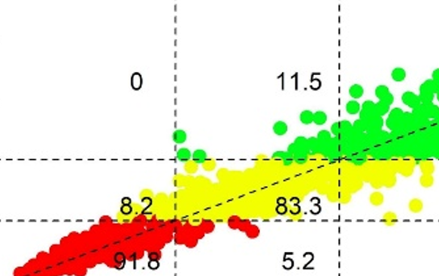


EcoTest Phase III: Simulation Testing Ecosystem Indicators for Secondary Species
Tom Carruthers, Quang Huynh & Nathan Taylor
SCRS/2024/87
27th March 2024, ICCAT SC-ECO

Slide 2
Contents
Priorities for the testing and developing ecosystem indicators for secondary species
The EcoTest framework
Data archetypes for secondary species
Indicator data streams and quantities
Information content of data
Next steps
Feedback required!

Slide 3
1. Priorities for the testing and developing ecosystem indicators for secondary species
Priority 1: Identify Target Variable (objective of indicators – what do you care about?), for example:
SSB / SSBMSY aka ‘Brel’(overfished / underfished)
F / FMSY (underfishing / overfishing)
Brel relative to mean of other species (relative stock level)
Frel relative to other species (relative overfishing)
SSB trend in recent years
Priority 2: Quantitative interpretation of Target Variable (what should an indicator reliably identify?), for example:
Brel < 0.5 is undesirable, Brel > 1 is desirable
Frel > 1 is undesirable, Frel < 1 is desirable
Without a clearly stated Target Variable and an interpretation of that Target Variable it is not possible to evaluate or design ecosystem indicators for secondary species, and hence make progress.

Slide 4
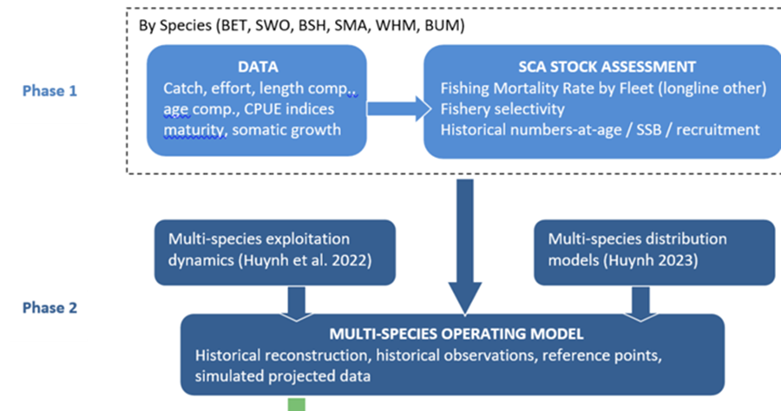
2. The EcoTest Framework
Huynh et al. SCRS/2022/106

Slide 5
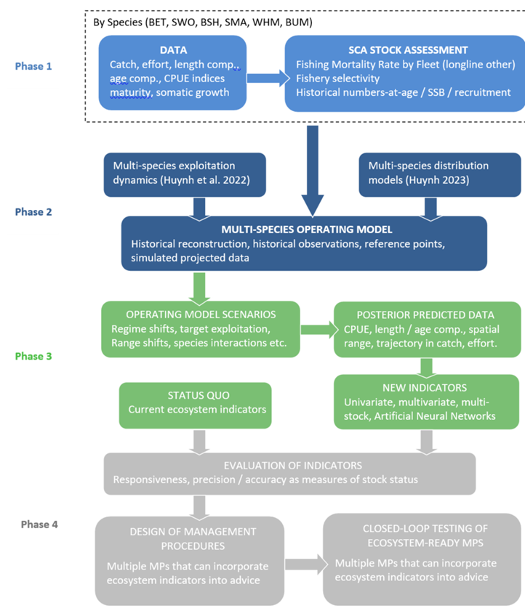
2. The EcoTest Framework

Slide 6
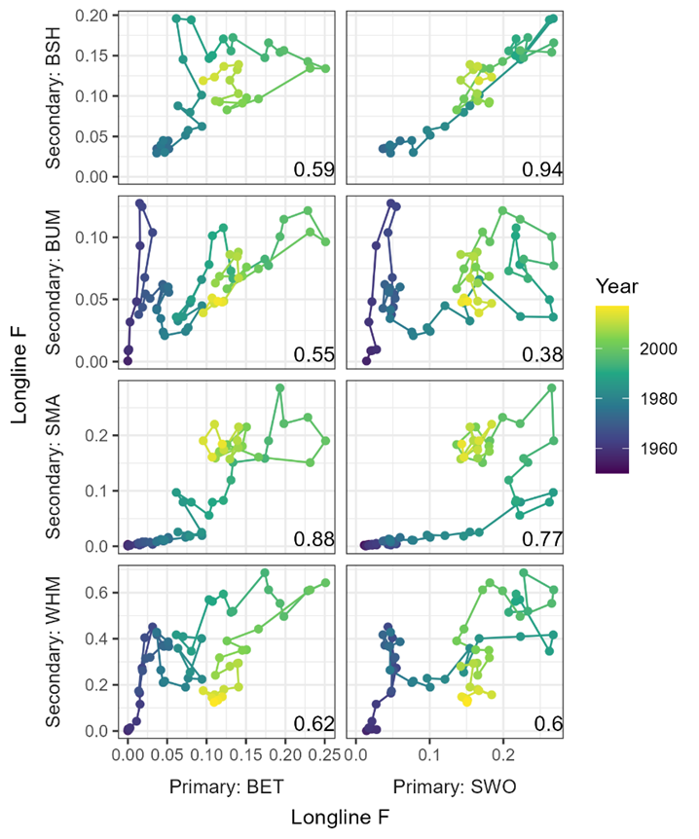
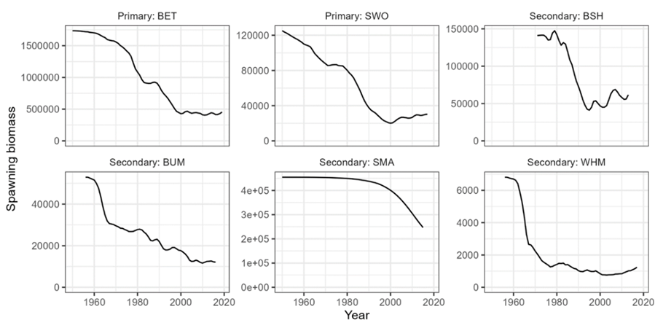
2. The EcoTest Framework: the North Atlantic longline case study
Phases I and II:

Slide 7
2. The EcoTest Framework: the North Atlantic longline case study
Phase III
Project various exploitation rate scenarios to generate posterior predictive data for all six species (Primary: swordfish, bigeye. Secondary: blue marlin, white marlin, blue shark, shortfin mako shark)
Posterior predictive data could include, catch (slope, current level relative to historical, correlations among species catches, ratios among species), length compositions, catch per unit effort, etc.
Can evaluate data types for information content with regard to target variables (stock status, overfishing, trends are simulated / known).
Flexible indicator systems such as artificial neural networks can be trained on multispecies data to evaluate the information content of data inputs.

Slide 8
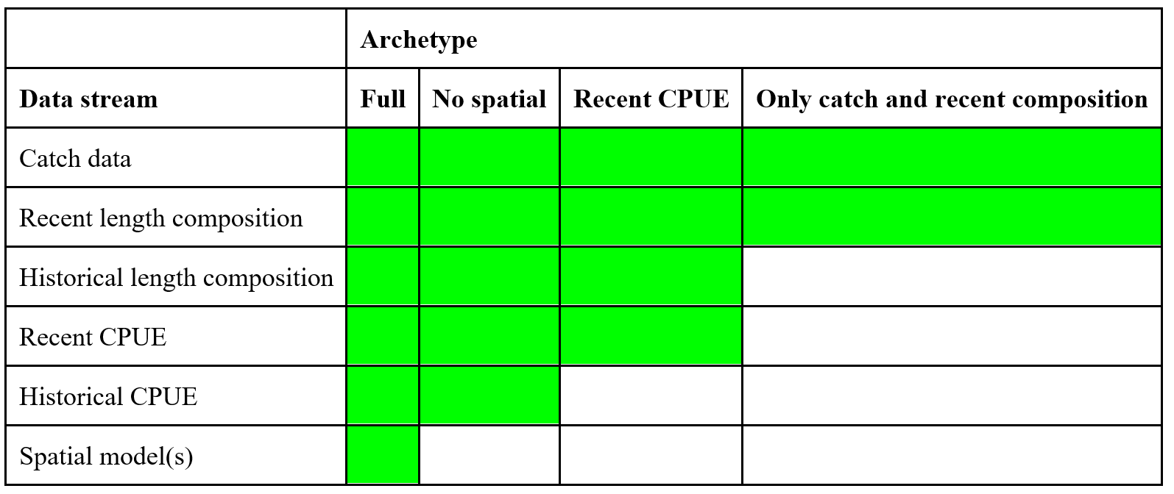
3. (Priority 3) Data Archetypes for Secondary Species
For example:

Slide 9
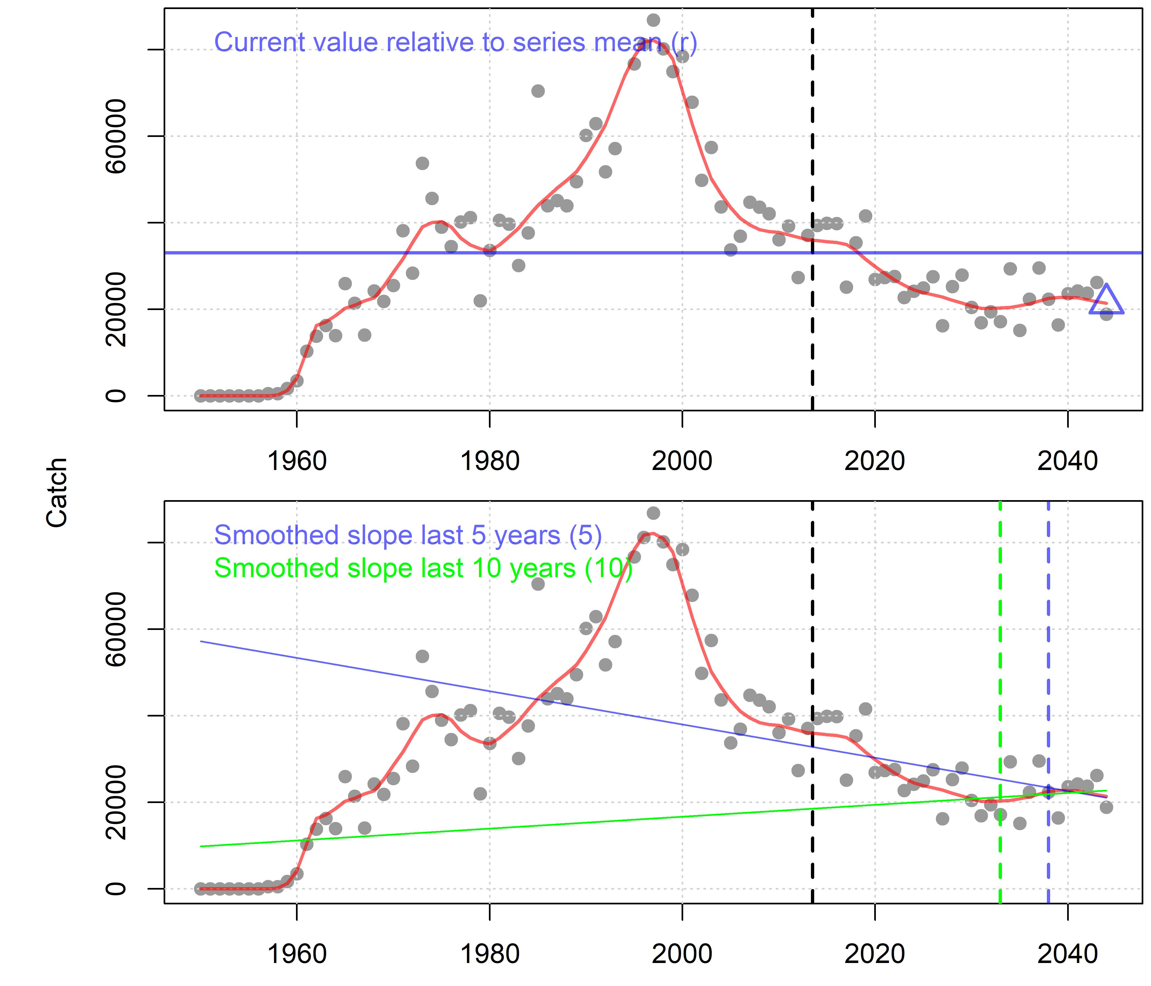
4. Indicator data streams and quantities: Time series data
Example time series data types:
Catch
Catch ratios (species x / species y)
Nominal CPUE
Mean length in catch
Variance of lengths in catch
Fraction mature in catch
Derived quantities for each data type:
Current level relative to series mean (r)
Slope over last 5 years
Slope over last 10 years
Slope over last 20 years
Residual error (around smoothed trend)
Observations
Loess smoother

Slide 10
4. Indicator data streams and quantities: species-specific life-history / fishery quantities
Life history:
M/K ratio
Maximum age (age to 0.5 survival)
Length at 50% maturity (L50) relative to asymptotic length (Linf)
Selectivity
Length at first capture relative to L50
Length at full capture relative to L50
Selectivity at asymptotic length
Coupled with the time-series quantities there are up to 330 possible data inputs to an indicator of a single species stock status (for example).

Slide 11
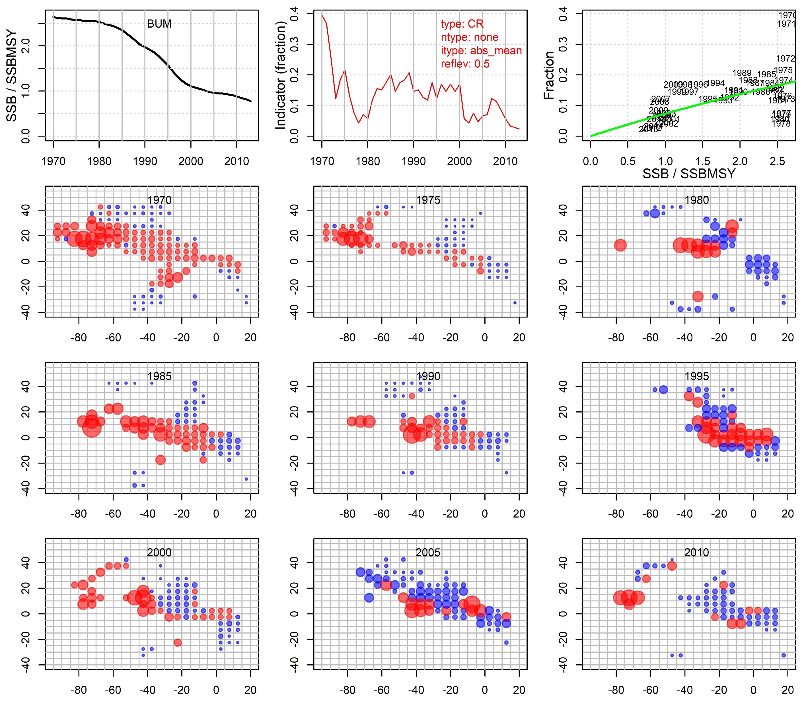
Spatial models
What could the 5x5 Task II data tell us?
Investigated range (fraction) of annual 5 x 5 cells with nominal Japanese CPUE higher than half the historical mean level

Slide 12
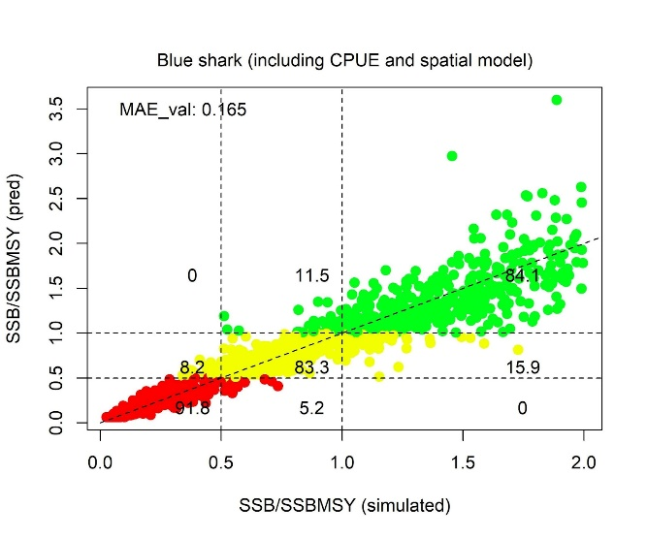
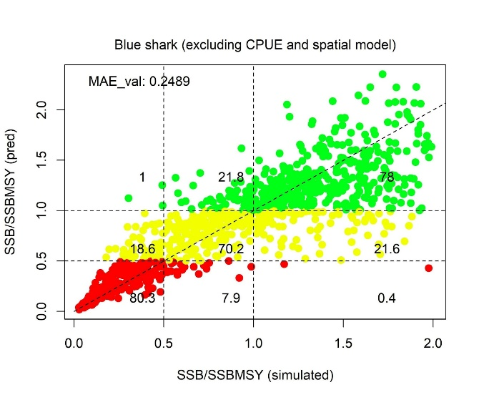
5. Information content of data
Predictive performance of a neural network fitted to true blue shark stock status (SSB / SSBMSY) using all data inputs (left panel) and all data inputs except CPUE time series and the spatial model (right panel). The plotted data are for a completely independent testing dataset of 1000 data points. The mean absolute error of the validation dataset is included in the top left of each panel. Plotted points are color coded according to the predicted categorical stock status defined by the horizontal lines at 0.5 and 1.0 SSB / SSBMSY.

Slide 13
6. Next steps (Phase IV)
Make longline simulations that span a very wide range of exploitation / stock status
Conduct robustness testing to time varying dynamics such as changing somatic growth, recruitment and natural mortality
Consolidate existing indicators
Develop new indicators & test against stock assessments / by simulation
Develop management procedures that use the indicators to modify management advice for secondary species
Conduct a ‘mega simulation’ to generate datasets for a more general indicator approach.

Slide 14
7. Feedback required!
Target Variables
E.g., SSB / SSBMSY
Quantitative interpretations of target variables
E.g., SSB / SSBMSY < 0.5
Input data archetypes
E.g., catch only, catch & length, catch & effort & length

Slide 15
Acknowledgements
EcoTest is funded by ICCAT as part of a commitment to the Global Environmental Facility (GEF) Common Oceans ABNJ Tuna Project Fund.
Many thanks to The Ocean Foundation for funding Phases I and II of the EcoTest framework.
Thanks to Adrian Hordyk and Alex Hanke for their helpful comments on an earlier version of the framework.

